Slide 1

BLAST DATABASE
Muzi Li

Slide 2
Address the Requirements
model.py
Define the database model
Blast_DB.py
Compute all pairwise blast alignment and build the database
RetrieveAlignment.py
Retrieve the blast alignment for two proteins from the database
Orthologs.py
Find pairs of orthologous proteins that are mutually best hits
Packages and Modules:
sys
os.path
Bio.SeqIO
Bio.Blast
Notes:
sys is used to pass the command-line arguments to the script. It can also report a standard error on the terminal and exit the program when an error occurs. (module)
os.path is used check the existence of the files. (module)
Bio.SeqIO is used to parse the protein fasta files. (module)
Bio.Blast is used to deal with BLAST programs and output.
NcbiblastpCommandline is a class used to do the protein blast.
NCBIXML is a submodule used to parse the xml blast results.
Bio.Blast: module
Bio.Blast.Applications: submodule NcbiblastpCommandline: class
Bio.Blast.NCBIXML: submodule

Slide 3
DEMO
Two species' proteomes: E.coli and yeast proteomes from UniProt
Protein
id | accession | name | description | organism
5 columns, 11030 rows
Alignment
id | query | subject | length | e_value | query_seq | match_seq
7 columns, 59878 rows
Foreign Key

Slide 4
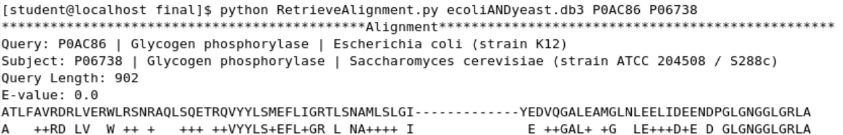
DEMO
Test RetrieveAlignment.py (P0AC86, P06738)

Slide 5
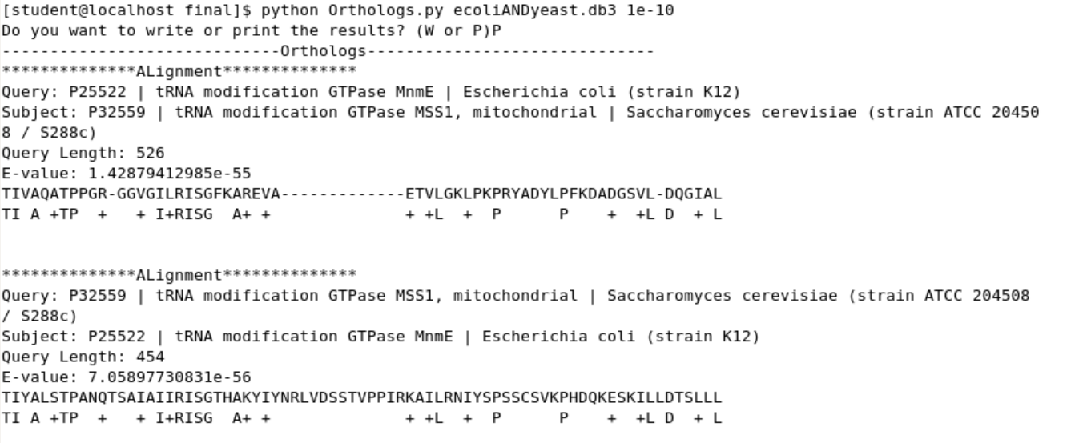
DEMO
Test Orthologs.py

Slide 6
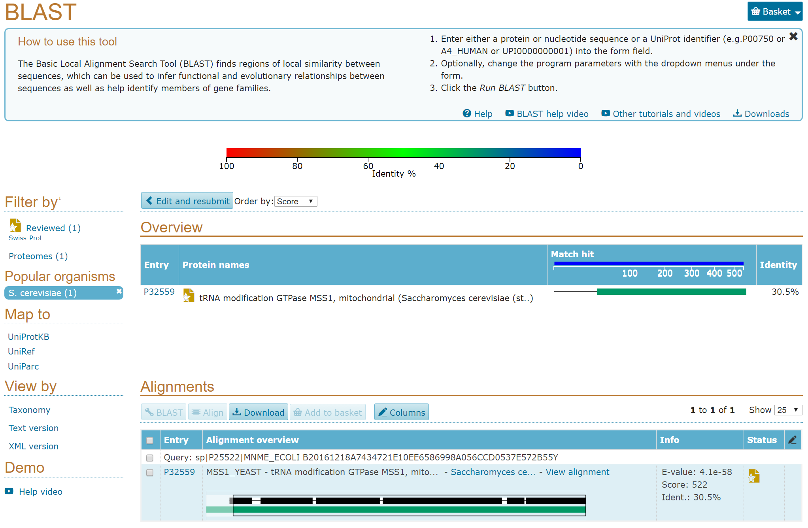
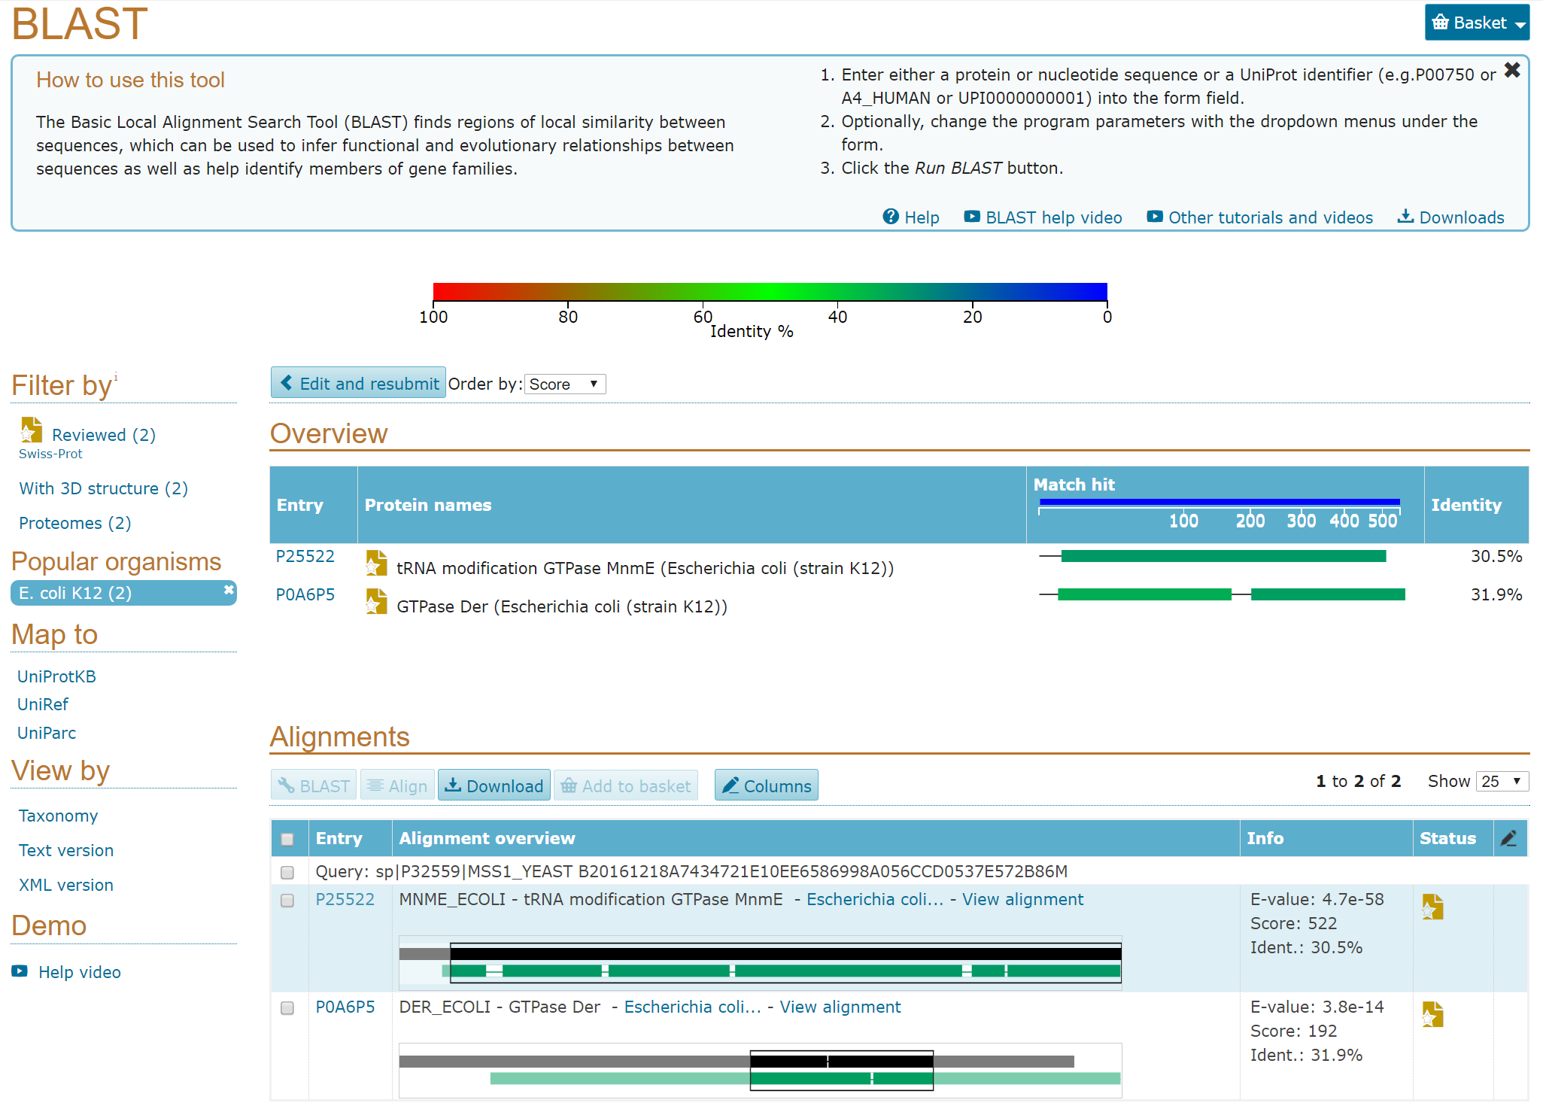
Verification

Slide 7

Verification

Slide 8
Strengths
Blast_DB.py:
1. Check whether the database has already existed.
If the database has existed, the program will ask the users whether they want to drop the existed tables and create new ones.
2. Check whether the blast results have existed.
If the blast results do not exist, the program will run the blast.
Orthologs.py:
The program allows the users to decide whether they want to print out the results or write the results into a file.

Slide 9
Scientific Tradeoff
The program asks the users to input the e-value on the command-line to get pairs of orthologous proteins. However, the e-value is kind of arbitrary.
Weakness
The program fails to take protein information from protein fasta files downloaded from other sources.
The users need to prepare the blast database first before they run the program.
Notes:
# Set the blast program and arguements as strings blast_prog = '/usr/bin/blastp' blast_args = '-query query.fasta -db blastdb/yeast.aa' # The Popen instance runs a program proc = Popen(blast_prog + " " + blast_args, stdout=PIPE, stderr=STDOUT, shell=True)

Slide 10

Bioinformatics
Interesting field that combines computer science and mathematics to analyze and interpret complex biological information embedded in our genome.
We can work from anywhere once we have a laptop and its battery doesn’t run out.

Slide 11

Programming
Don’t be too satisfied with your code.
A good program is not the program that just doesn’t produce an error.
Notes:
For me, I don’t believe perfect code.
Every time when I look back at my code , there are always something I need to add or improve.

